Slide 1
Crypto Project
Purpose: To study Bitcoin
Compare 2 specific Trading Strategies
Goal:
Create a system that is expandable to other markets such as fitires, stocks etc
A customizable framework for backtesting
Potentially allow for actual trading through API

Slide 2
The 2 strategies tested
Simple Moving Average
Exponential Moving Average
What are the trade triggers
Let’s look at the code in detail

Slide 3
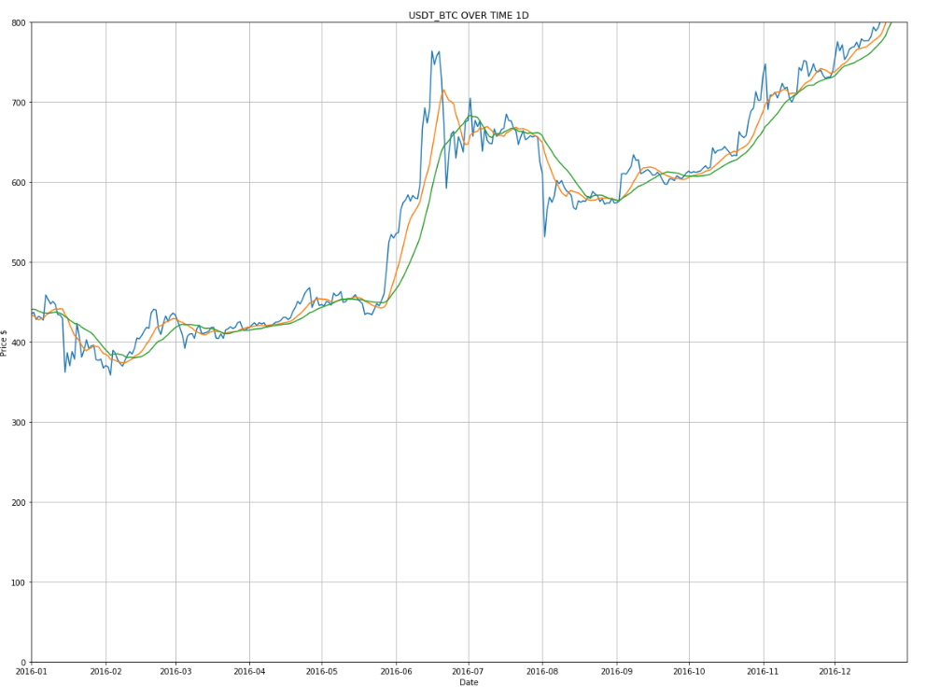

Slide 4
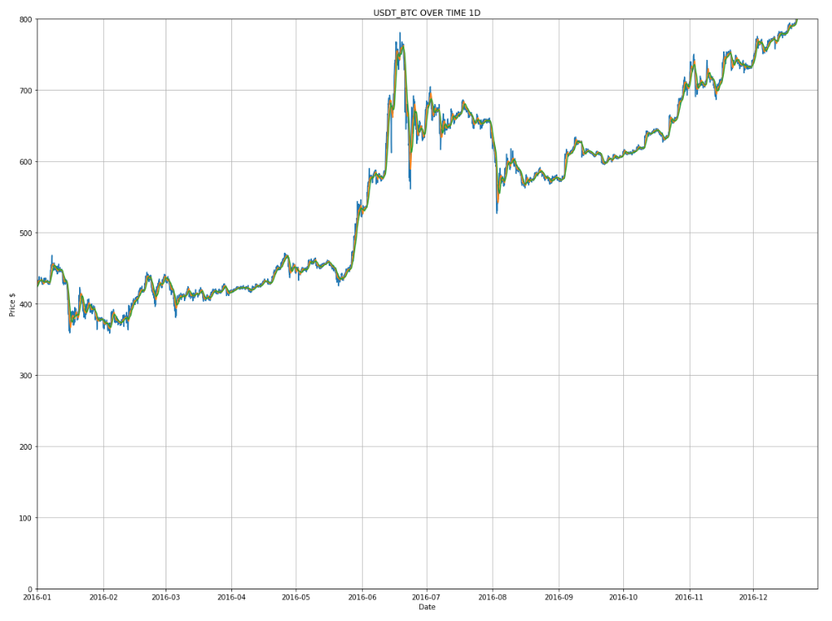

Slide 5
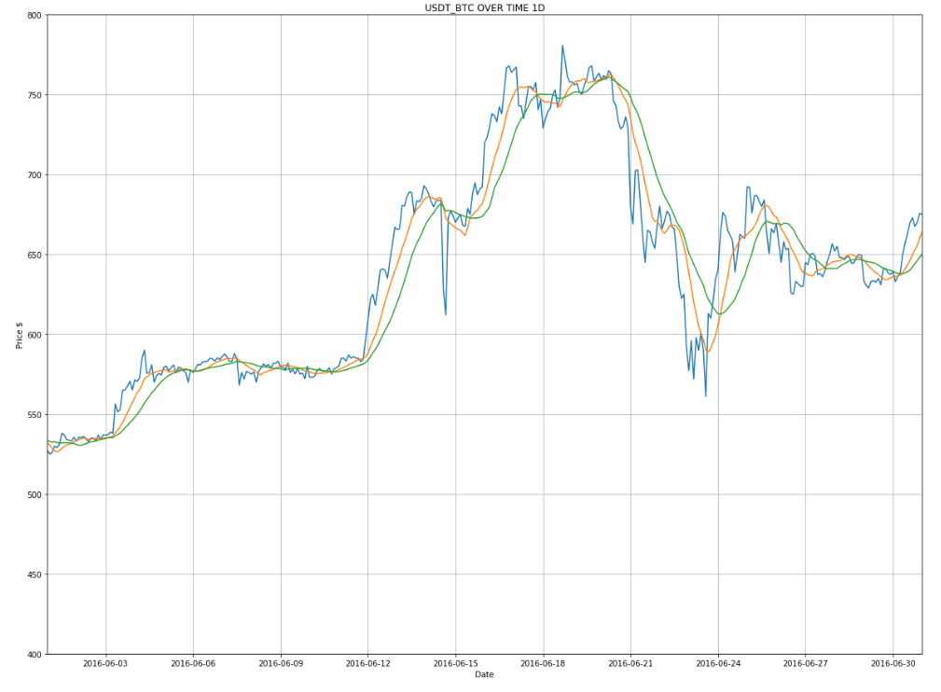

Slide 6
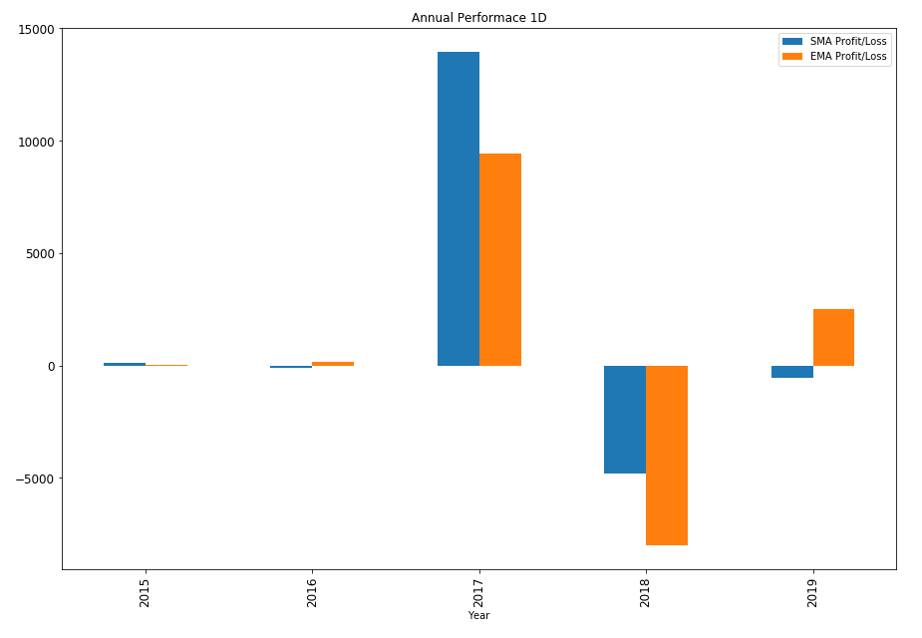
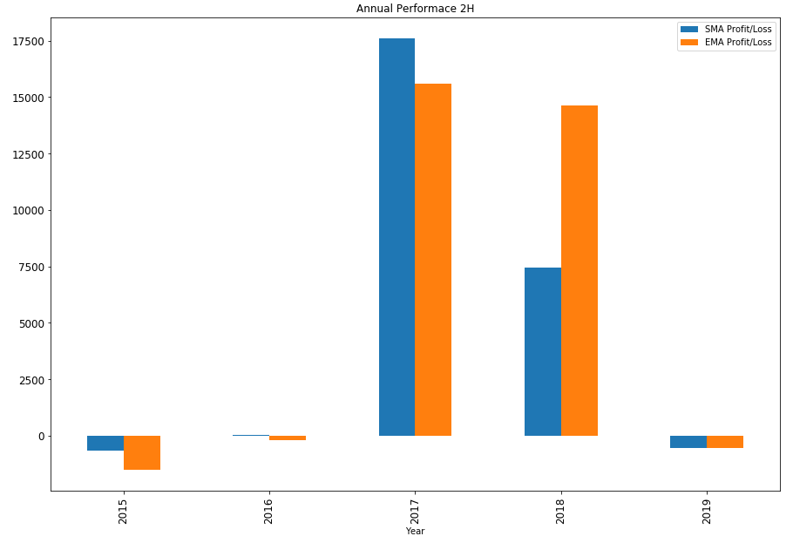
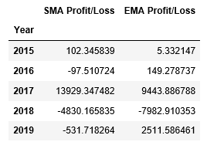
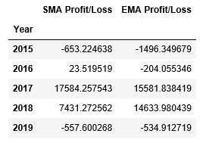

Slide 7
